Slide 1
Middlebury College – Blackbaud Event Module Training

Slide 2
Middlebury College – Blackbaud Event Module Training
There are FOUR Basic Steps
Making the event in NXT
Getting your Data
Making the Event PART in Page Builder and adding the EVENT to it
Making the Event PAGE in Page Builder and adding the PART to it

Slide 3
Middlebury College – Blackbaud Event Module Training
There are FOUR Basic Steps
Making the event in NXT
Getting your Data
Making the Event PART in Page Builder and adding the EVENT to it
Making the Event PAGE in Page Builder and adding the PART to it

Slide 4
Middlebury College – Blackbaud Event Module Training
Start at the main events page here:
https://host.nxt.blackbaud.com/event-mgmt/?svcid=renxt&envid=p-9e8gVA6GVkCm7VhKg0DqUA
You will need to click the ADD EVENT button in the top left
NOTE – you can also do all of these same steps in Database view and save yourself some back and forth, if you are so inclined.

Slide 5
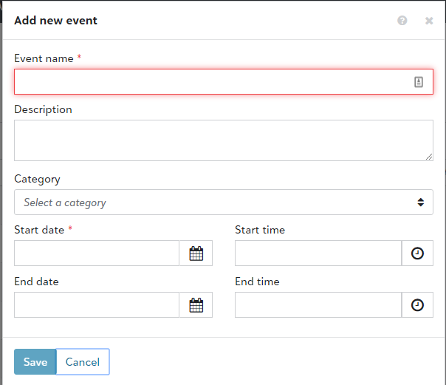
Middlebury College – Blackbaud Event Module Training
Event Name – This is public facing. Please make sure it is descriptive and includes a location
Event Description – This is where to put the Who, what when where and why. THIS IS PUBLIC FACING!
Category – Pick from dropdown, if you are not sure please check with another event coordinator.
Start / End Date and Time – This will be used to pull the event into calendars so please double check! This STAYS at the time zone you are making the event.
Hit save!

Slide 6
Middlebury College – Blackbaud Event Module Training
You’ll now see your event in the events page.

Slide 7
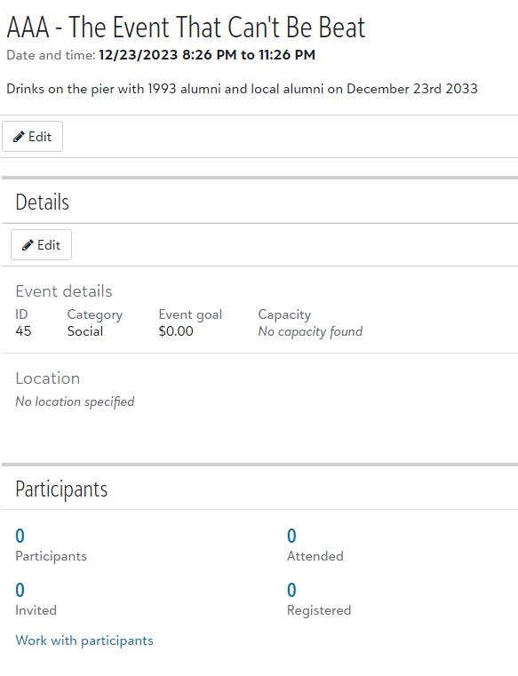
Middlebury College – Blackbaud Event Module Training
Click Edit EVENT DETAILS Change event ID to this format
EVT
Year
Date of event
i.e. EVT20191107
If that number is already taken go ahead and an A, B or C on the end

Slide 8
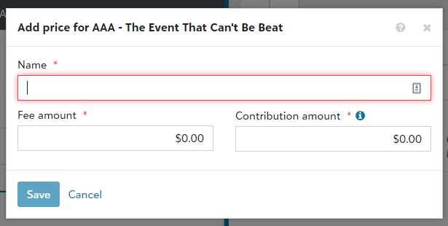
Middlebury College – Blackbaud Event Module Training
Every event needs at least one price, even if it’s $0. To do that click ADD PRICE (usually called INDIVIDUAL).
Then add the name and the fee amount, leave at $0.00 if free.
Always leave the contribution amount at $0.00.

Slide 9
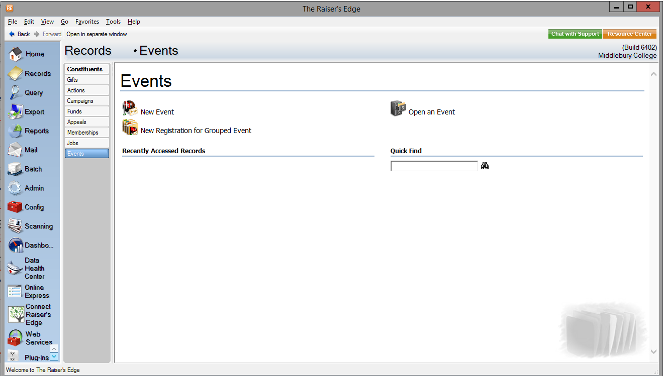
Middlebury College – Blackbaud Event Module Training
We now need to go back over to DATABASE VIEW, log in, select RECORDS and then EVENTS, and use the OPEN AN EVENT or the event # in the QUICK FIND box to open our event.

Slide 10
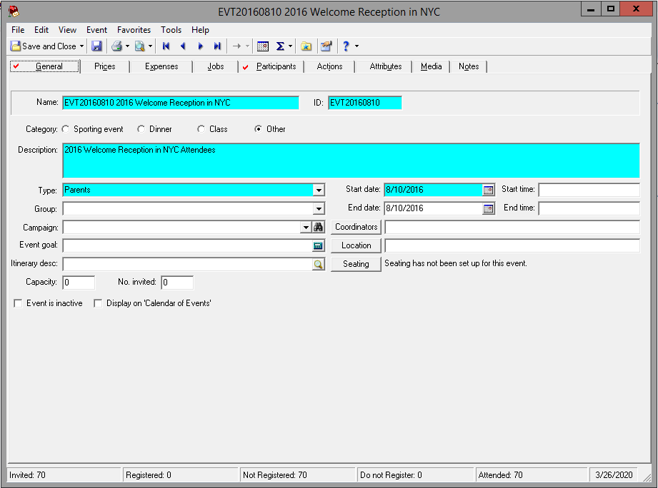
Middlebury College – Blackbaud Event Module Training
If you’ve registered for your own event, search for your name here and make yourself the EVENT COORDINATOR here. Please only add 1 Coordinator per event
Add the location here, note only the TOP LINE pulls through to the calendar, so consider starting with the street address
All Events must have a type
Keep capacity at 0
Is your event ready for the calendar, click this box, otherwise make sure it’s unchecked

Slide 11
Middlebury College – Blackbaud Event Module Training
Only the top-line “Location” field will pull through to the events calendar, so put something in there that will make sense when seen alone and not just raise more questions (not “Joe’s Pub,” but maybe “Joe’s Pub, 123 Main St, Cincinnati, OH”)—if you want everyone, not just registrants, to have the exact location information
HOWEVER
Be careful with the tokens you use in your confirmation email (assuming the event has a BBNC reg form), because that top-line field pulls through as the location name field, so you may wind up with
Joe’s Pub, 123 Main St, Cincinnati, OH
123 Main St
Cincinatti, OH
…in your confirmation email. If you put the full address in the top-line location name field, then just delete the other location line tokens from the confirmation email.

Slide 12
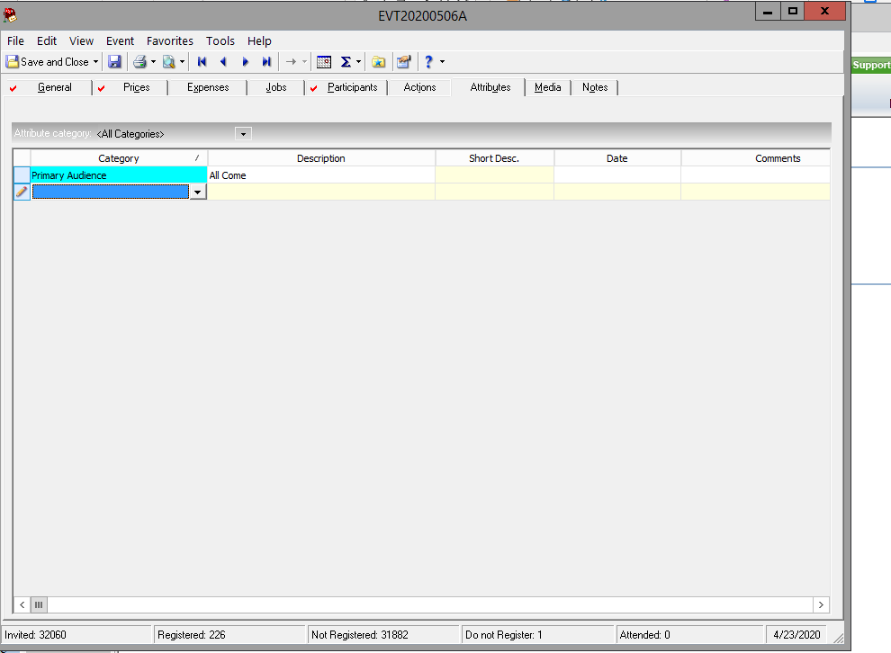
Middlebury College – Event Module Training
We are building new Attributes for Events to provide the ability to see more information on them in aggregate. For now, please make sure you add a Primary Audience. More detail will be coming soon.

Slide 13
Middlebury College – Blackbaud Event Module Training
There are Four Basic Steps
Making the event in NXT
Getting your Data
Making the Event PART in Page Builder and adding the EVENT to it
Making the Event PAGE in Page Builder and adding the PART to it

Slide 14
Middlebury College – Blackbaud Event Module Training
When it comes to your event data ask yourself:
Is your data COMPLICATED?
Are you pulling in multiple constituencies and filtering them down?
Is your data EASY?
Are you pulling a small, focused list? (e.g. all alumni living in or near Austin, Texas)
EASY
COMPLICATED
You can pull the list yourself with the NXT list functionality
Work with Carol or Dana to pull a list

Slide 15
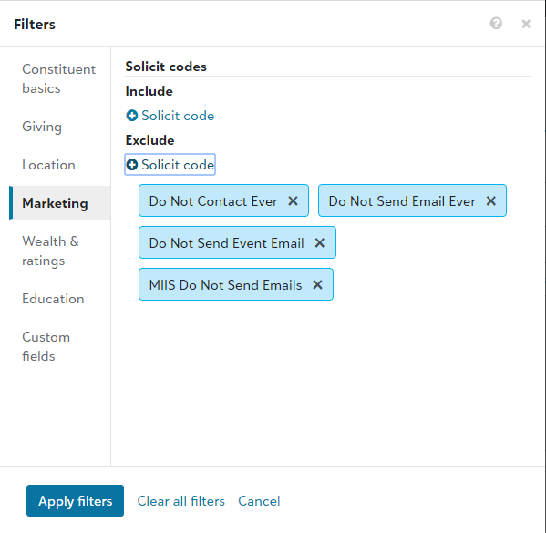
Middlebury College – Blackbaud Event Module Training
For Easy data pulls, you can use the list functionality in NXT.
You will need to create your list with your criteria.
Make sure you REMOVE the following Exclusion codes from the Marketing tab when creating filters:
Do Not Contact Ever
Don Not Send Email Ever
Don Not Send Event Email
And if sending a MIIS Event: MIIS Do Not Send Emails

Slide 16
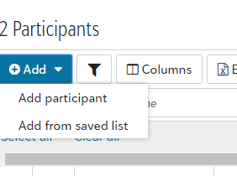
Middlebury College – Blackbaud Event Module Training
Once you have your list you can download to Excel, remove the folks without emails and send the email out via iMods (for now)
Then you can add the list you created to your event by going to NXT, opening your event, clicking Work with participants
Then click Add from a saved list and upload your saved list as invited.
Note: This will include some without emails, this is OK.

Slide 17
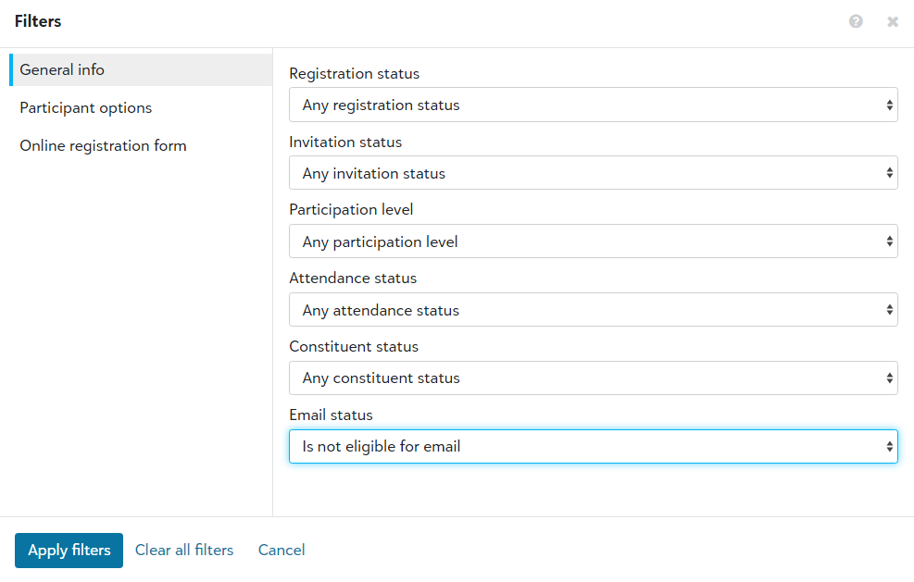
Middlebury College – Blackbaud Event Module Training
To make your list clear as to who was actually invited, and who would have been invited if we had had an email for them, do the following:
Go to your list of invited
Hit the filter button
Under “Email status,” select “is not eligible for email”
Apply filters
Select all
At the bottom of the window, click “update invitation status”
Make sure “not invited” is selected
Click “Save”
This will leave all the people with no email address attached to the event (so you can see who would have been invited if they had an email address), but not invited or registered.

Slide 18
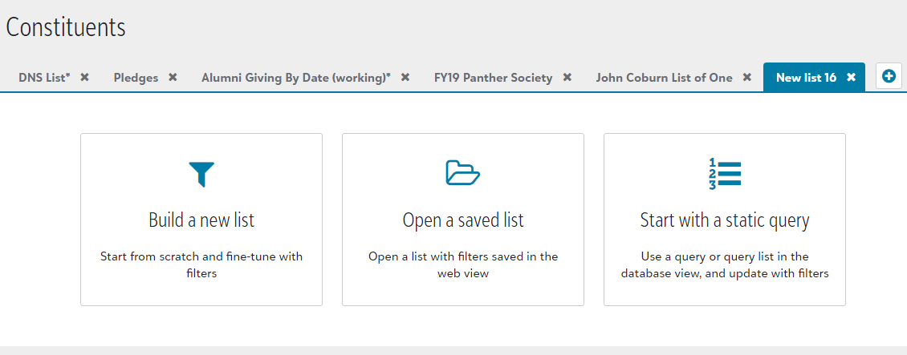
Middlebury College – Blackbaud Event Module Training
If you had a complicated data request Carol and Dana will send you the information on the name of the Query used to get your data.
You will then need to go to Lists, create a new list and choose: Start with Static Query
Choose your static query and open the list.
NOTE: it will say it is including inactive and deceased, it is NOT these have been removed in the query.
Next save this list with a name you can recognize.

Slide 19
Middlebury College – Blackbaud Event Module Training
NOTES:
Event registrations are pulled through daily by Records team.
Please alert them prior to any pressing deadline
Complicated forms lead to more time consuming entry, sometimes one transaction can take 5 minutes to match and pull through
Sometimes things happen when pulling through the data, it is strongly recommended you review the registrants prior to sending any message to them (e.g. Sometimes a phantom guest record is created for a participant)
If we can’t match the person to a record in the database, they will be added as a “guest of Middlebury College” so that they can appear in your lists without us creating a record for them.

Slide 20
Middlebury College – Blackbaud Event Module Training
There are Four Basic Steps
Making the event in NXT
Getting your Data
Making the Event PART in Page Builder and adding the EVENT to it
Making the Event PAGE in Page Builder and adding the PART to it

Slide 21
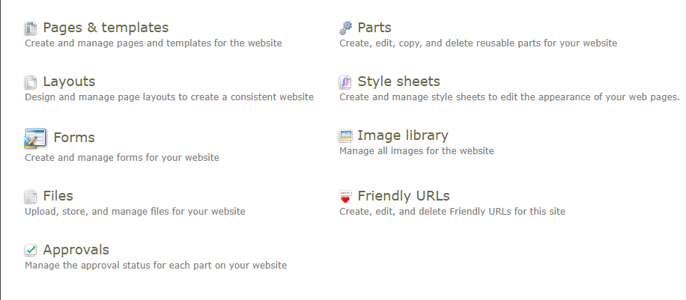
Middlebury College – Blackbaud Event Module Training
Log in to https://engage.middlebury.edu/login.aspx
Then open https://engage.middlebury.edu/cms/contenthome and go to the parts section.

Slide 22
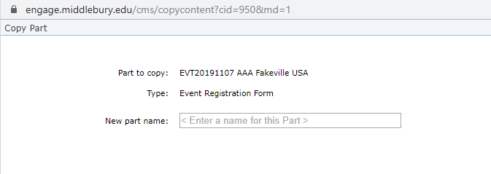
Middlebury College – Blackbaud Event Module Training
Ideally, you want to copy a PART that matches a similar event, find one and click the copy icon.
Re-name the part with the event ID included.

Slide 23
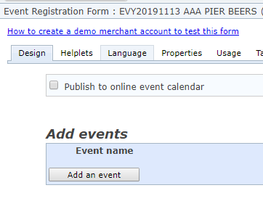
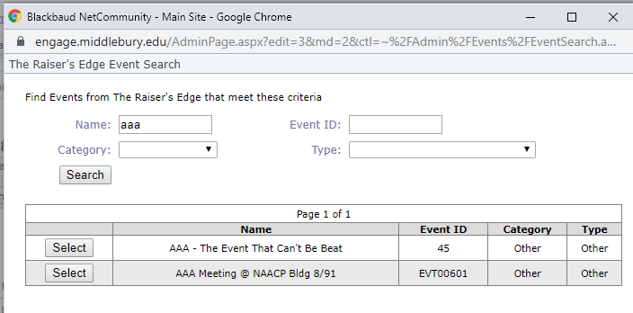
Middlebury College – Blackbaud Event Module Training
Click to make sure this gets pulled to the internal and external calendars. This puts a "register now" button on the public-facing calendar (if your event is shown there). Click this when you've tested your form and are ready for people to register
Click to add an event to this event part.
Search for your event and add it via the select button.

Slide 24
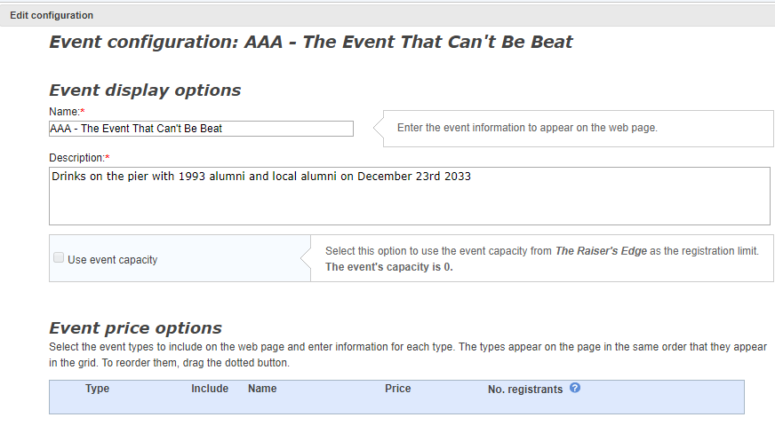
Middlebury College – Blackbaud Event Module Training
Make this the same name and description as the first time.
Check this box if you are using capacity.
Open up the registrant.

Slide 25
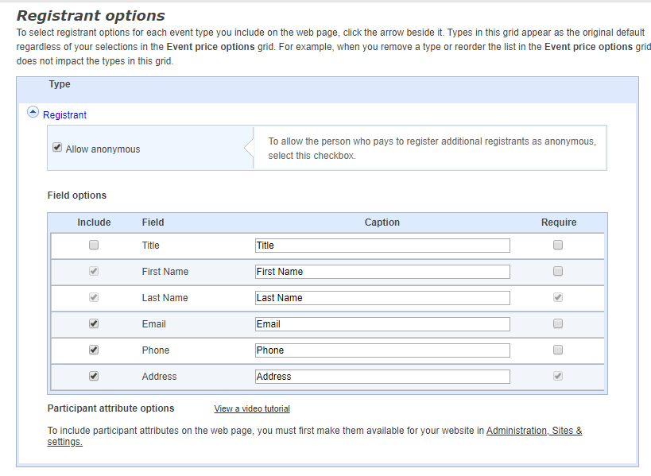
Middlebury College – Blackbaud Event Module Training
Unclick this box.
Decide which information should be required with the REQUIRE column on the right and which they can simply choose to enter with the INCLUDE column on the left, then click SAVE. Please REQUIRE First name, last name, address and email.

Slide 26
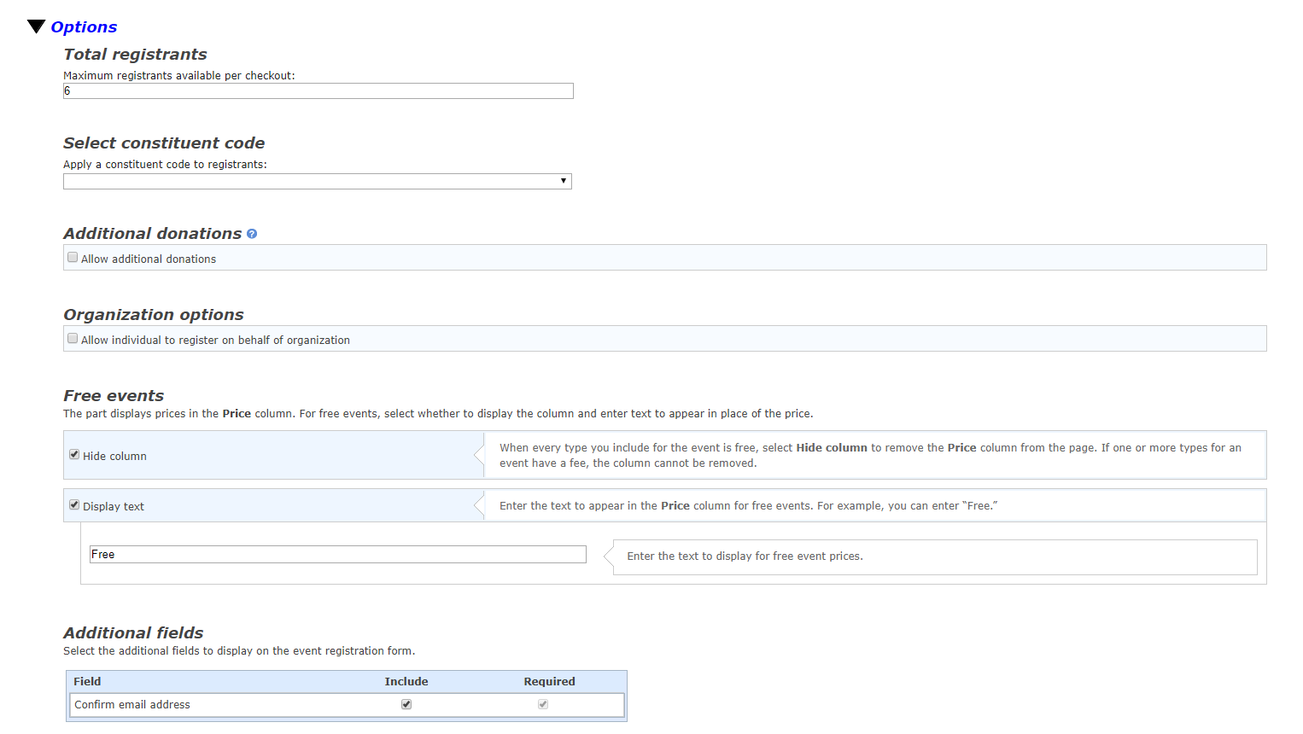
Middlebury College – Blackbaud Event Module Training
If you expand OPTIONS your first option is adding a total number of people per registration, which is not often utilized.

Slide 27
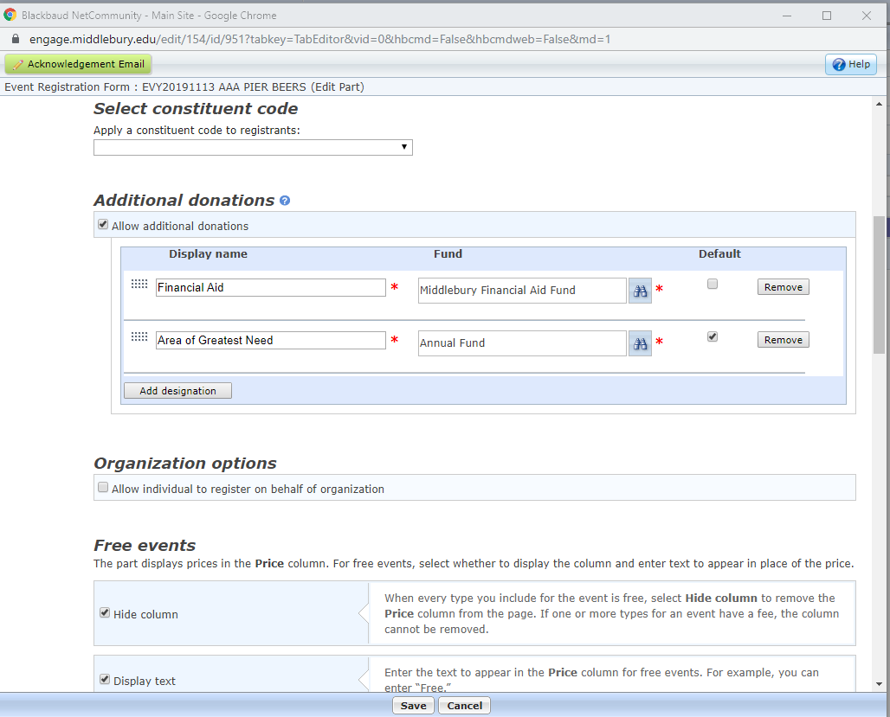
Middlebury College – Blackbaud Event Module Training
There are three types of events when it comes to fees.
Free – This field doesn’t matter
Free with additional gift (this is recommended for free events) – This field should be set to
Event fee with no additional gift

Slide 28
Middlebury College – Blackbaud Event Module Training
If you select ADDITIONAL DONATIONS you’ll need to search for the correct funds to display (usually Financial Aid, Area of Greatest Need and Annual Fund are the most common).
If you want one fund to be DEFAULT check this box to the right, and to order the funds click and drag them by the gray grid on the left.

Slide 29
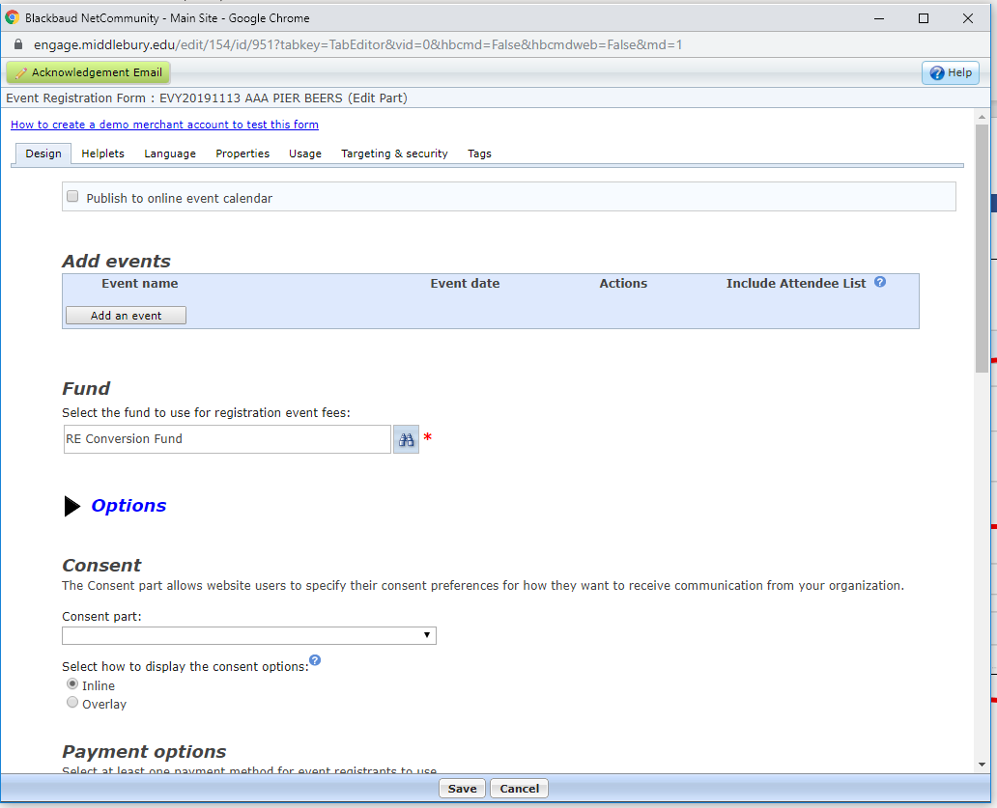
Middlebury College – Blackbaud Event Module Training
Next click the PROPERTIES tag

Slide 30
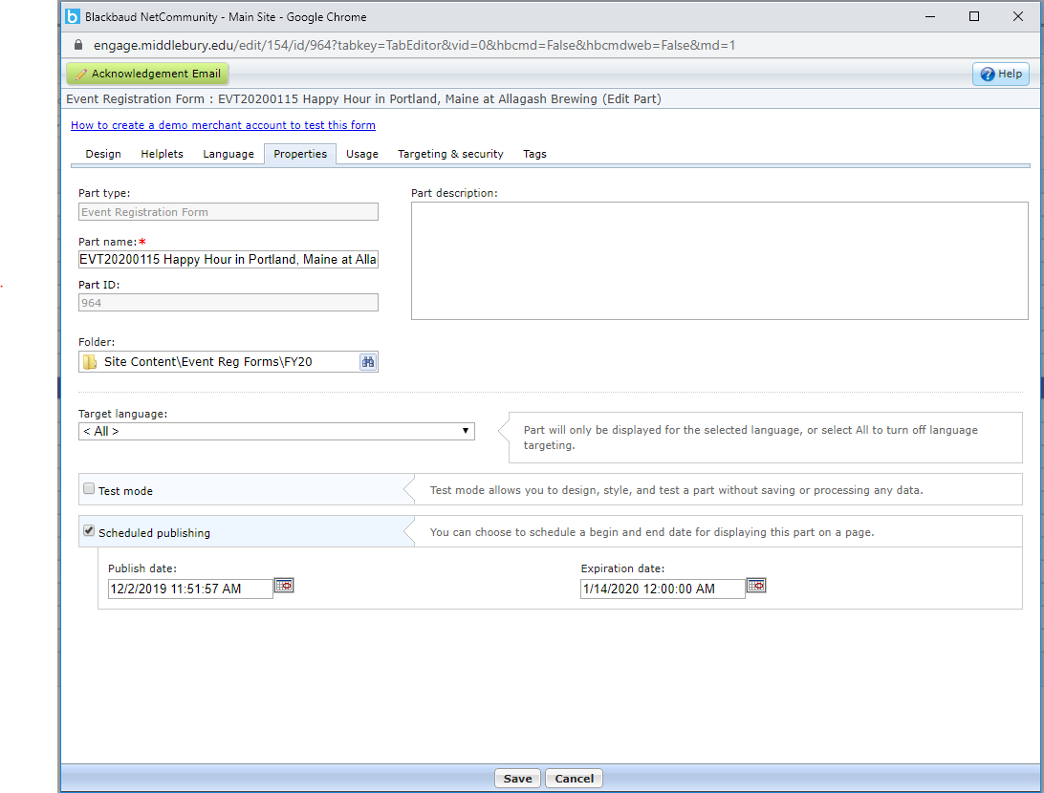
Middlebury College – Blackbaud Event Module Training
Here you can decide if you want to put an end date that this form will be available. This means that this form will not be viewable before the first date or after the second one

Slide 31
Middlebury College – Blackbaud Event Module Training
To EDIT the acknowledgement email scroll to the top of the page and hit the green ACKNOWLEDGEMENT EMAIL button.

Slide 32
Middlebury College – Blackbaud Event Module Training
Here you put the name of the email.
This is the subject of the email the registrant would see
Here is where you write the from address and name
Here you can set the address that the email will go to if the user hits REPLY

Slide 33
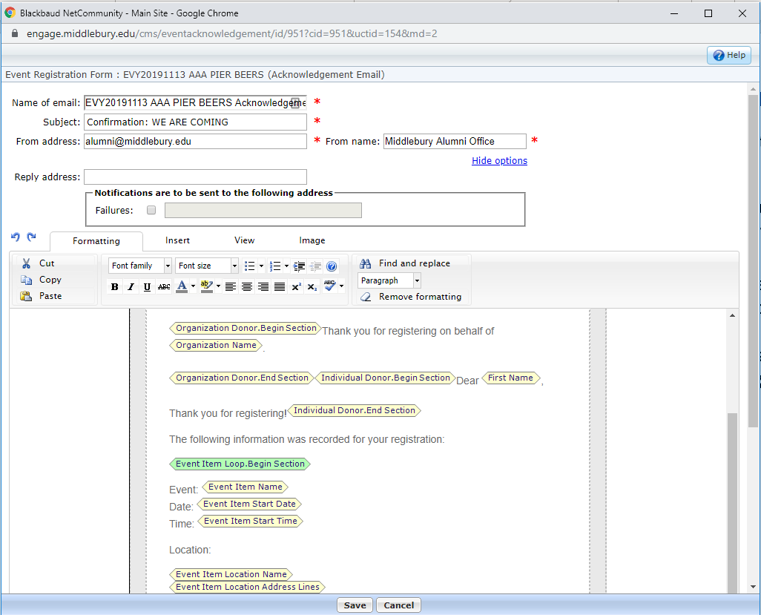
Middlebury College – Blackbaud Event Module Training
Below you can edit text and add tags from their file
Please make sure the fields are the ones you need. If this the first time you’re making an email for this type of event please make sure there’s no incorrect text or tags that will confuse our guests

Slide 34
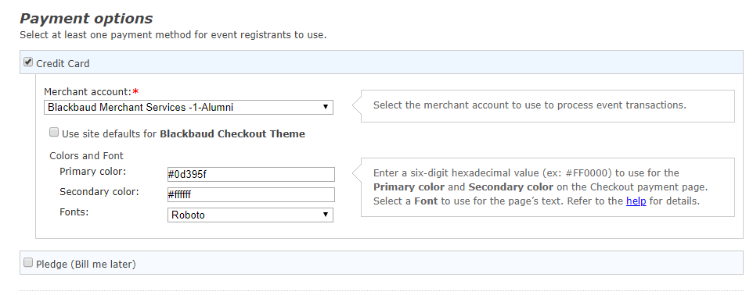
Middlebury College – Blackbaud Event Module Training
Make sure the account that ends in ‘-1-Alumni’ is selected – IF YOU ARE DOING FEE NO DONATION. If you are doing JUST donation pick THE OTHER ONE
These colors ae Midd approved do not change unless truly needful
Leave this unchecked

Slide 35
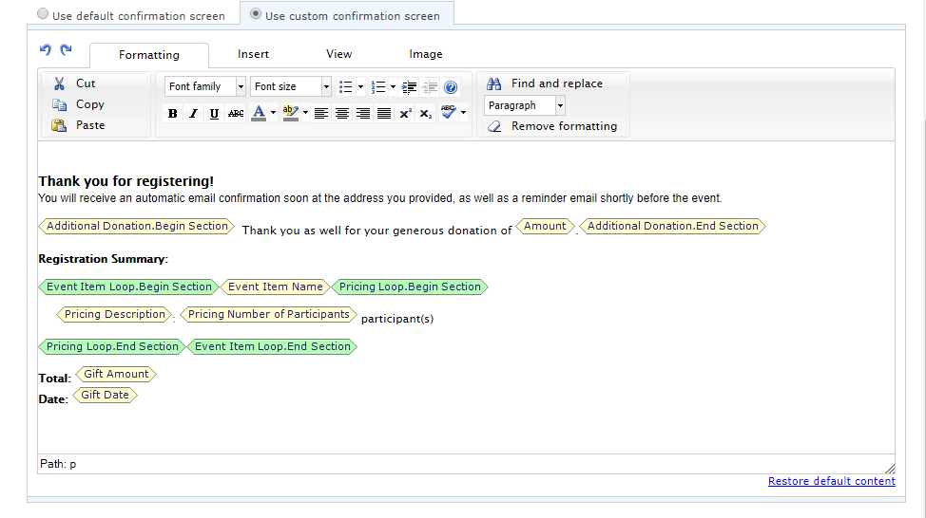
Middlebury College – Blackbaud Event Module Training
Hit save and you’re done making the part!

Slide 36
Middlebury College – Blackbaud Event Module Training
There are FOUR Basic Steps
Making the event in NXT
Getting your Data
Making the Event PART in Page Builder and adding the EVENT to it
Making the Event PAGE in Page Builder and adding the PART to it

Slide 37
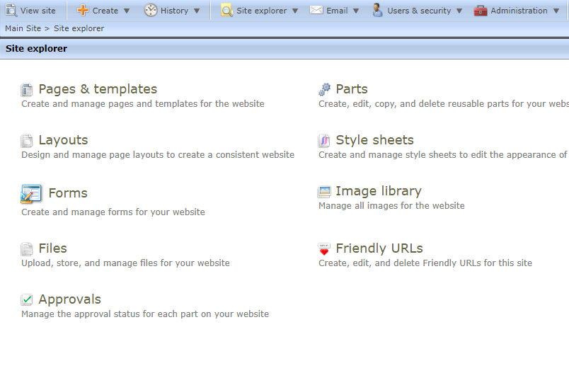
Middlebury College – Blackbaud Event Module Training
Go back to https://engage.middlebury.edu/cms/contenthome and this select PAGES and TEMPLATES

Slide 38
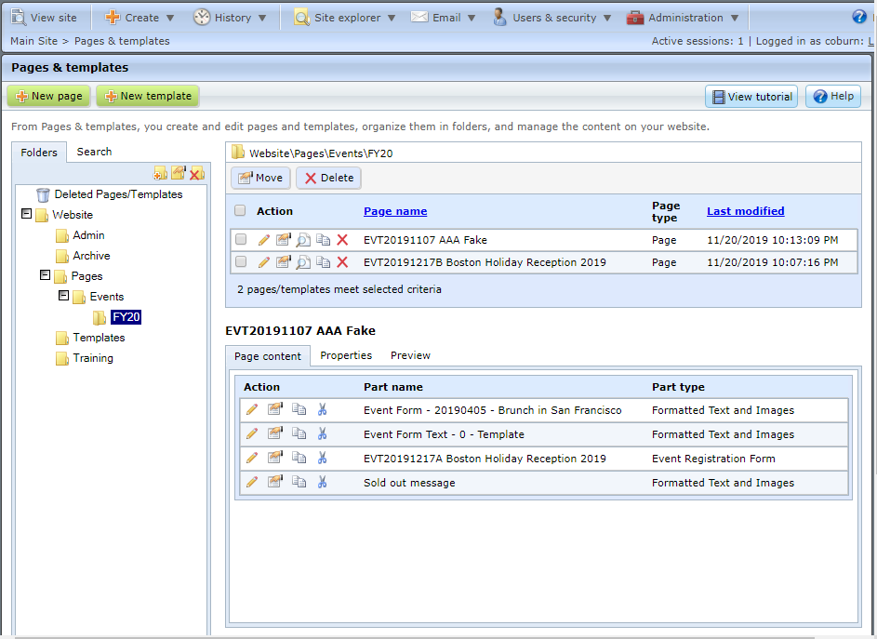
Middlebury College – Blackbaud Event Module Training
Look through the folders to find the event folders
Find a similar event page and hit the COPY icon

Slide 39
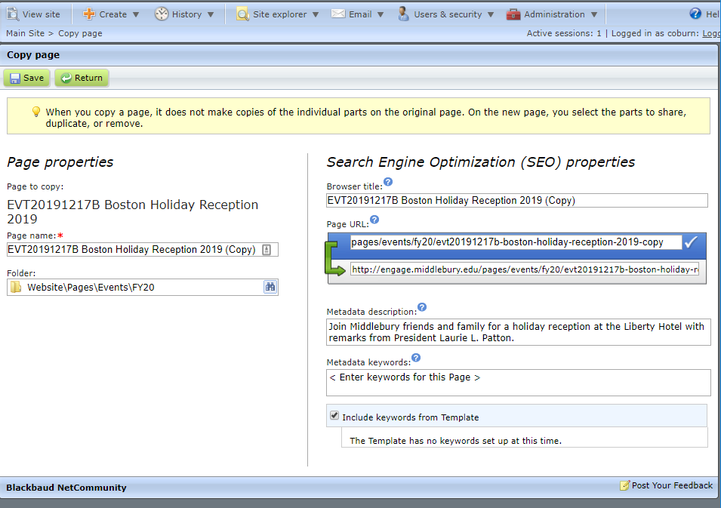
Middlebury College – Blackbaud Event Module Training
Put the page name here, make sure the event number leads the title. This is not visible to the public.
This is the title that shows up ON THE PAGE so make sure it makes sense – Make sure you remove the EVY code and add MIDDLEBURY
Here you can edit the URL, also copy and paste it for future use!
This is nice to enter, but not necessary, this is what would show up if you paste the link to Facebook
When done, hit SAVE

Slide 40
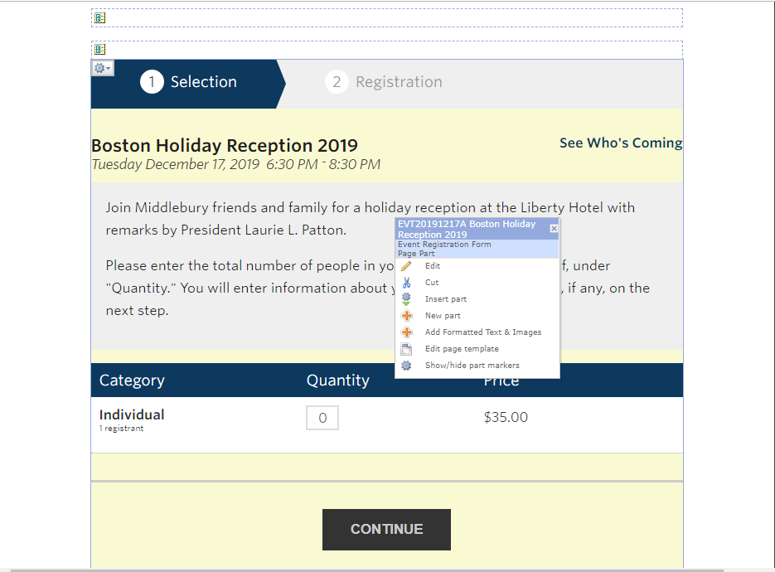
Middlebury College – Blackbaud Event Module Training
On the new page, find the cog near the top of the event form part, select INSERT PART and insert the event part you just made then REMOVE the old event part. You may have to remove the old part before inserting the new part. Also, if you have an expiration date or a date you no longer what to accept registrants make sure you swap this out for a REGISTRATION CLOSED part later!
Now you’re done! Use the URL you copied earlier to sent out the event.

Slide 41
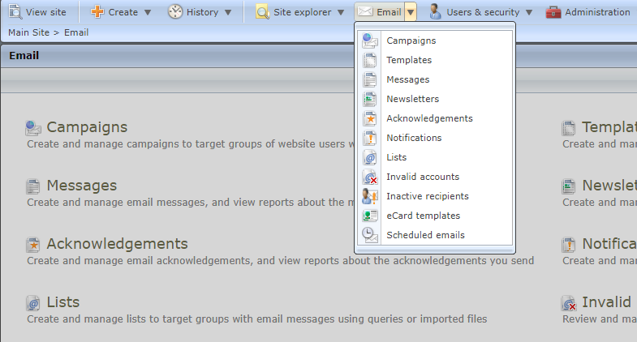
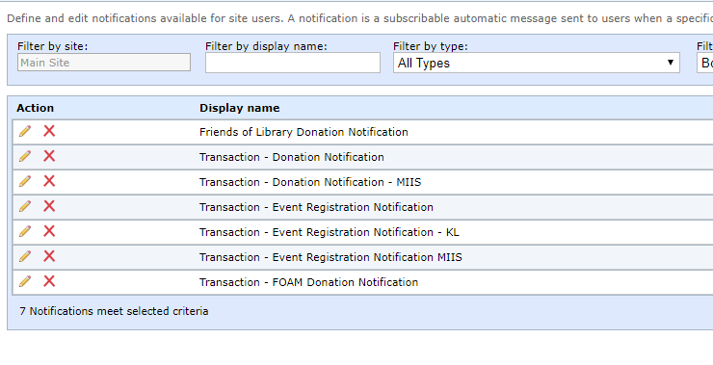
Middlebury College – Blackbaud Event Module Training
IMPORTANT – AFTER YOUR EVENT IS FINALIZED IF YOU WANT TO BE NOTIFED VIA EMAIL WHEN SOMEONE REGISTERS YOU NEED TO DO THIS LAST STEP
Go to the EMAIL tab in BBNC
Select NOTIFICATIONS
Find the notification email that fits your department and select the pencil to edit it

Slide 42
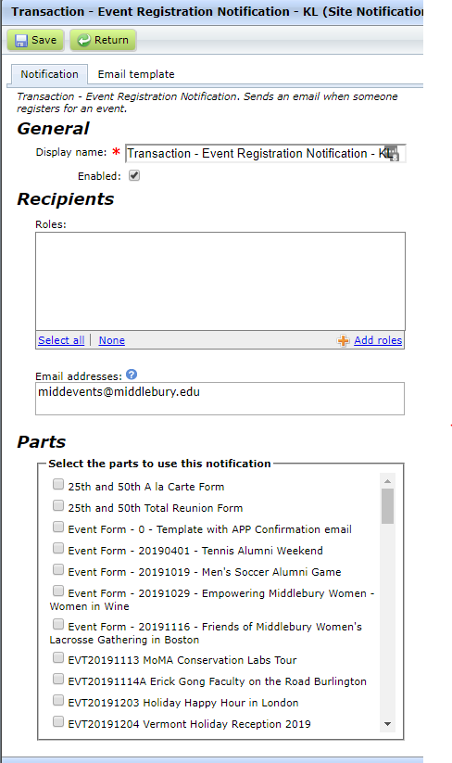
Middlebury College – Blackbaud Event Module Training
Verify the email it’s going to is correct, if not you might have the wrong notification email
THIS EMAIL IS FOR MULTIPLE EVENTS SO PLEASE DO NOT REMOVE / ALTER THE EMAIL ADDRESSES WITHOUT GLOBAL APPROVAL
Find your new event in this list and click to add it to the email
Remember to hit save when you’re done!

Slide 43
Middlebury College – Blackbaud Event Module Training
Appendix A – Who is Coming Form

Slide 44
Middlebury College – Blackbaud Event Module Training
Open up database view and go to QUERY
Under QUERY find the EVENT ATTENDANCE folder and click it, then click and open any existing QUERY

Slide 45
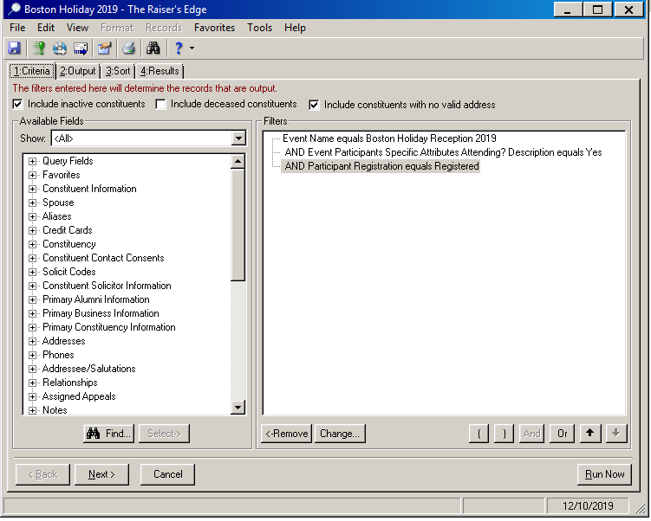
Middlebury College – Blackbaud Event Module Training
First click FILE and SAVE AS with your event ID and Title
Then right click and select CHANGE on the first item, search and find your event and hit OK
Then hit save and exit database view

Slide 46
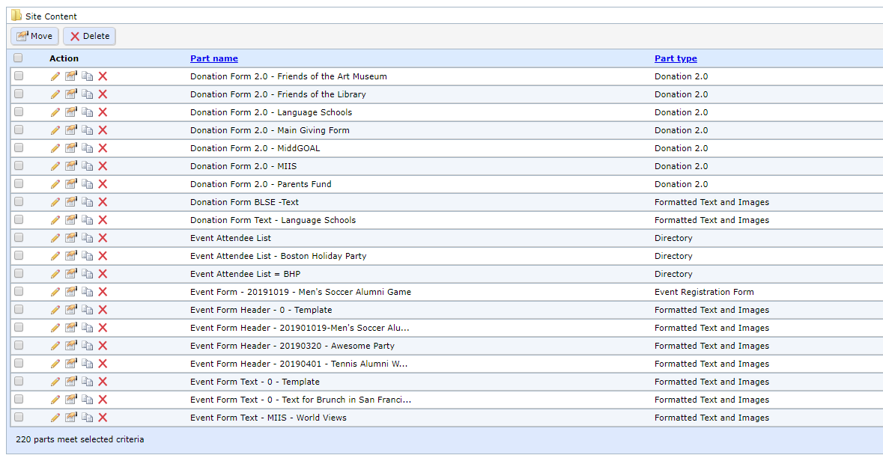
Middlebury College – Blackbaud Event Module Training
Now go back to where you build parts and pages, go to PARTS and find an existing EVENT ATTENDEE LIST part and duplicate it,

Slide 47
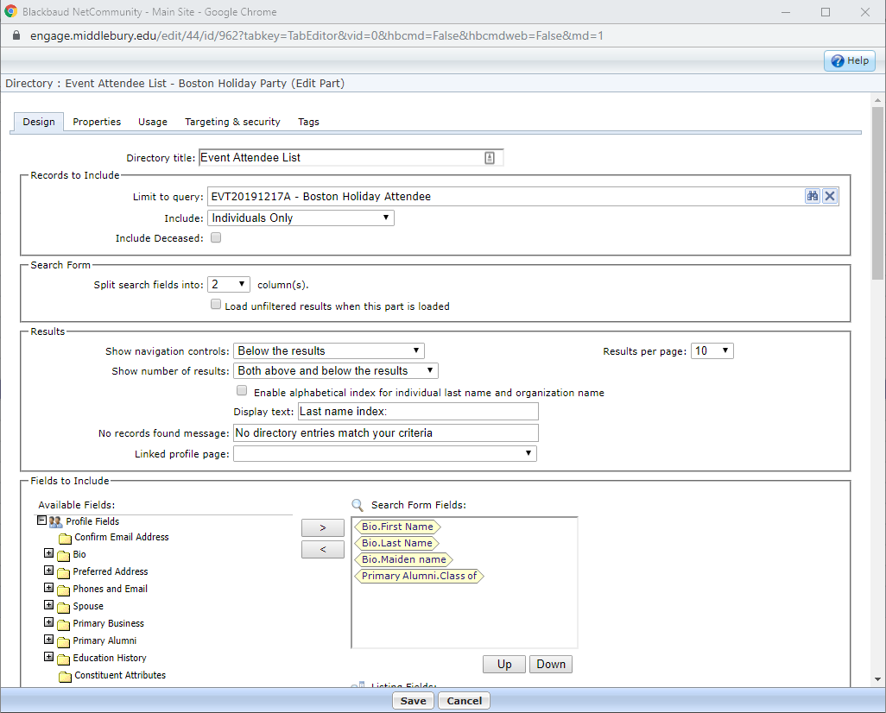
Middlebury College – Blackbaud Event Module Training
Give it a name inline with your event
Search and select the query you made in the previous step
Hit SAVE

Slide 48
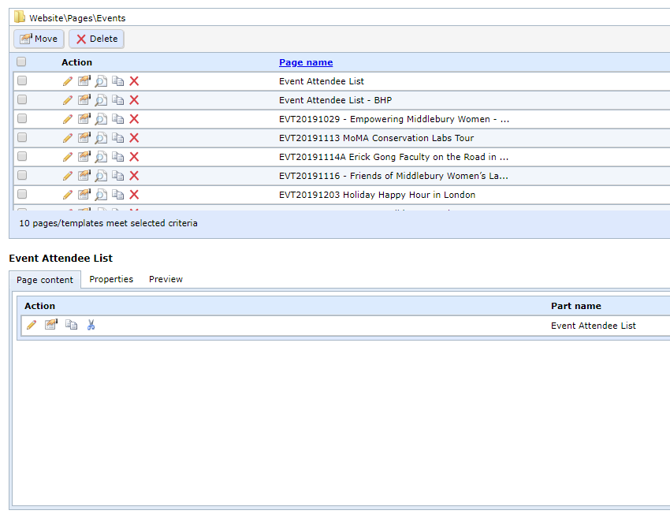
Middlebury College – Blackbaud Event Module Training
Just like with our event, we need to make a page to host the part, so find a similar page, copy it and name it inline with your event.

Slide 49
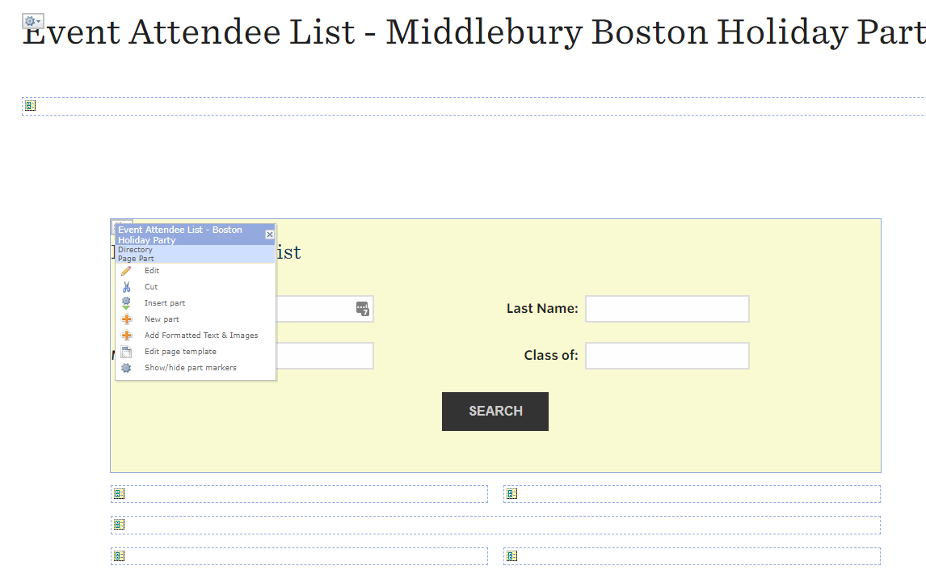
Middlebury College – Blackbaud Event Module Training
Again, just like last time we need to insert the part we just made and remove the existing part then hit save.

Slide 50
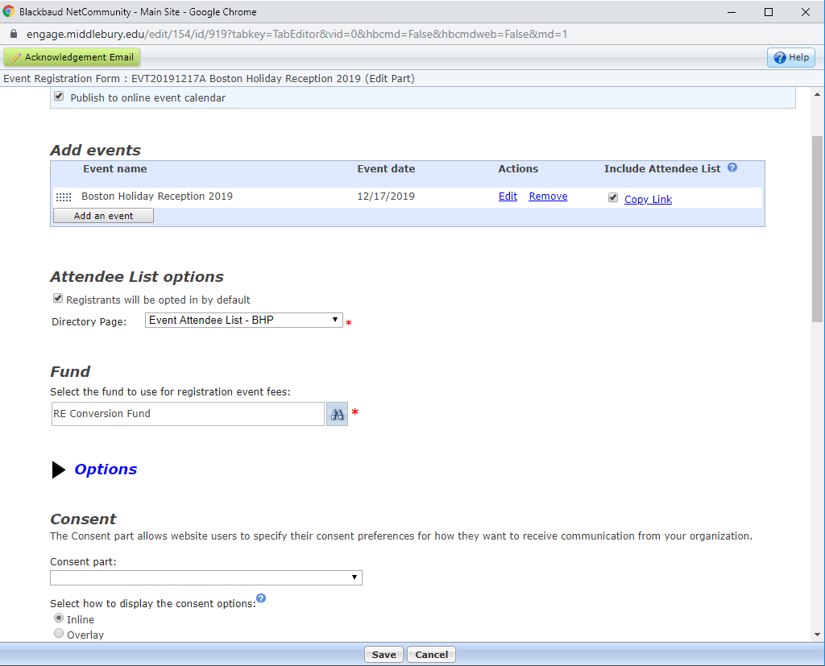
Middlebury College – Blackbaud Event Module Training
Going back to the main event PART we see we can now select the event page we just made and have it pull just attendees for our event.

